Slide 1
hour 8
Working with Landscapes:
Landscape and Foliage Tools

Slide 2
Introduction
In this lecture, you will be introduced to working with the Landscape and Foliage editing tools. Landscape tools are powerful and allow for large areas of world creation that can be edited per segment, which means you can quickly edit for game space expansion and tailor the game for efficient rendering.

Slide 3
Lecture Goals and Outcomes
The goals of this lecture are to
Learn to work with Landscape tools and settings
Learn about using height maps
Learn how to use Landscape Materials
Learn how to use Foliage tools and settings
By the end of this lecture you will be able to
Use Landscape tools
Create a Landscape Actor
Apply a Material to a Landscape Actor
Apply foliage to the game space

Slide 4
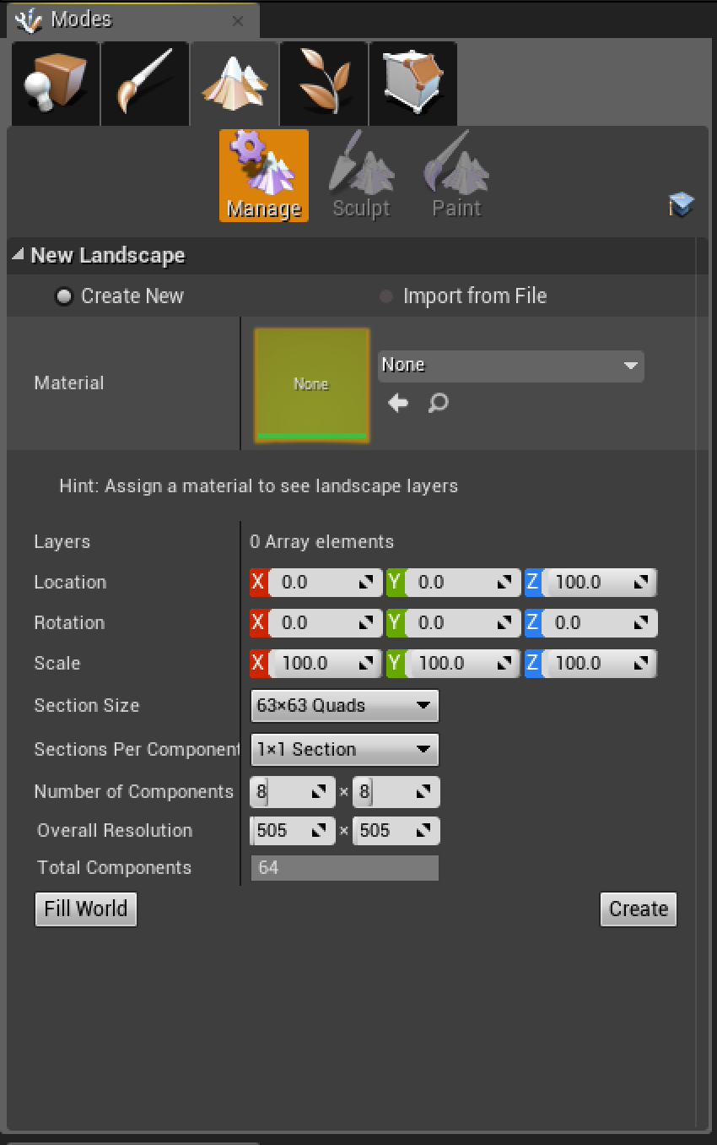
Landscape Tools
The Landscape tools can be found by clicking the mountain icon in the Modes panel.
You can also press Shift+3 to quickly bring up the Landscape panel.

Slide 5
Landscape Tools
Three major tabs are available on the Landscape panel:
Manage: This tab controls the construction and management aspects of the Landscape.
Sculpt: This tab changes the volume and form of Landscape geometry.
Paint: This tab controls the Material type applied to the Landscape’s surface.
Note: The Sculpt and Paint tabs are grayed out and unusable until you create your first base Landscape.

Slide 6
Manage Tab
The Manage tab allows you to create and manage existing Landscape Actors.
You can create a new Landscape based on set parameters, or you can create one based on an imported height map.

Slide 7
Working with Landscapes
A height map is a Texture that provides elevation information based on a gray scale.
White pixels indicate higher elevations, and black pixels indicate lower elevations.
Note: Height maps can be authored in other sculpting or photo-manipulation programs and then imported and used in UE4, or they can be made directly in UE4 by using Sculpt tools.

Slide 8
Creating Landscapes
When creating a Landscape, you need to assign a Landscape Material.
A Landscape Material holds the Textures that define the various surfaces that make up your Landscape, such as dirt, sand, and rock.

Slide 9
Creating Landscapes
Transform settings allow you to pick the initial placement and orientation of the Landscape.

Slide 10
Creating Landscapes: Level of Detail
The LOD (level of detail) settings can be modified to enable the Landscape to render quickly and efficiently. These Landscape controls relate to how much information is displayed on screen at once.
A larger Section Size setting means there is less to render within the component or section, which is less processor intensive.
The higher the Sections Per Component setting, the better UE4 is able to divide and decide at what quality to render each section.

Slide 11
Creating Landscapes: Level of Detail
You can also change the settings for the density and size of each Landscape tile used to make up the larger Landscape whole. By default, each subdivided Landscape section or plane has a density of 1 vertex per meter. In the vertical, or z, scale, which is by default set to 100, the height range is 256 meters up or down.
These are important measurements to know when manipulating and controlling the density and size of these panels for a new Landscape. If you know these measurements, you can control the number of vertices on the entire Landscape by using the resolution settings and the number of overall Landscape segments along with components settings. By combining these settings, you can balance the resolution or density of vertices per Landscape section.

Slide 12
Creating Landscapes
The final two options for creating a new Landscape are the Fill World and Create buttons at the bottom of the Landscape panel.
The Fill World button creates a Landscape that is the size of the entire game space that is currently available.
The Create button simply confirms the settings that are currently in place and uses them to create a new Landscape.

Slide 13
CREATING Landscapes
To ensure a good frame rate, Section Size should be the most monitored setting in the Landscape panel. Increasing the Section Size setting too much will cause major drops in frame rate and Editor usability because of the processing power required.
There is a delicate balance between ensuring a high frame rate and a desirable quality of Landscape resolution. Experimentation is key here, as there is no easy answer about the optimal numbers for a project.

Slide 14
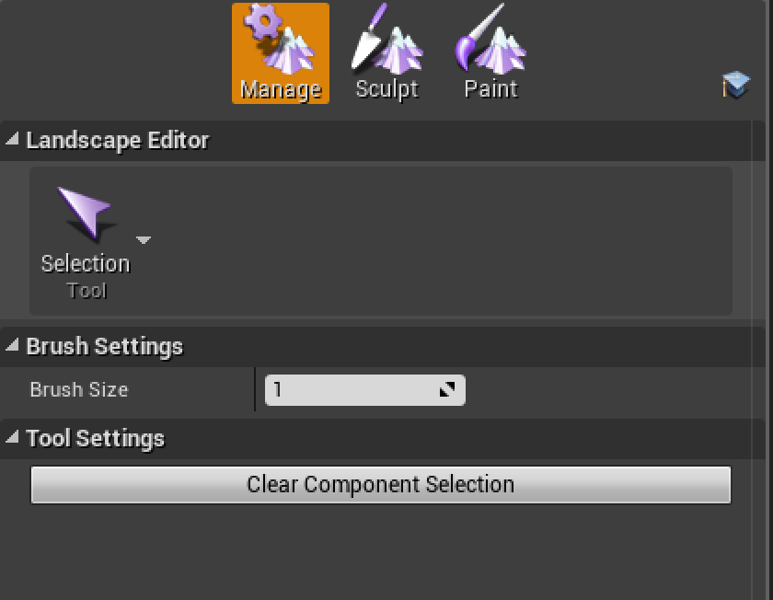
Creating Landscapes
Once you create a Landscape Actor, new options are presented under the Manage tab. These options allow you to select sections of the Landscape and add or remove new sections or modify existing ones.

Slide 15
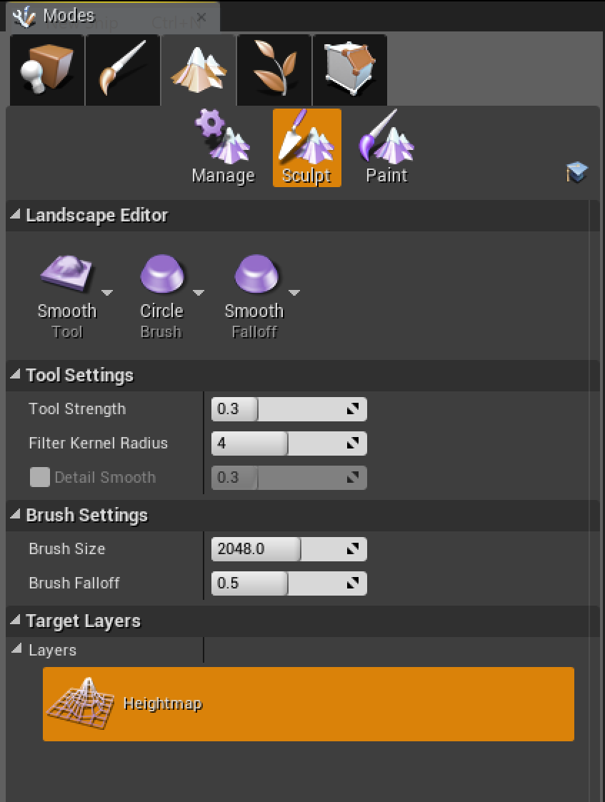
Sculpt Tab
With a Landscape Actor created, the Sculpt and Paint tabs become available.
The Sculpt tab has tools for deforming the surface of the Landscape. There are different brushes and properties for editing brush sizes and shapes.

Slide 16
Sculpt tab: Tool Menu
Tool | Description
Sculpt | This tool sculpts up or down into the Landscape mesh.
Smooth | This tool brushes smoothness or lessens the variation difference between areas being influenced by the Sculpt tool.
Flatten | This tool flattens the Landscape to the height specified when you first click the Landscape with the Flatten tool activated. It moves the Landscape terrain up or down, depending on the height value selected.
Ramp | This tool connects two areas by ramping the Landscape between the two with a constant change in grade between points.
Hydro Erosion and Erosion | This tool simulates general wear of the ground that happens in a world scenario to emulate this effect on the game space Landscape.
The table on the right shows some of the tools available in the Tool menu under the Sculpt tab.

Slide 17
Sculpt tab: Brush Menu
Tool | Description
Circle | This is the most basic and default brush. It is a circular-shaped brush.
Alpha | This brush uses a specific Texture as a mask influenced by a gray scale similar to a height map.
Pattern | This brush uses a repeating pattern across the whole of the Landscape, which acts as a mask for sculpting.
Component | This brush affects whole component pieces of the area being sculpted.
The Brush menu allows you to choose the overall shape of the tool being used on the Landscape.
There are four types of brushes.

Slide 18
Sculpt tab: Falloff Menu
Tool | Description
Smooth | This is the most commonly used type of falloff. It is a soft blend between the strong and weak parts of the brush.
Linear | This is a direct constant falloff.
Spherical | This is a weaker influenced falloff toward the center and increases to a stronger influence toward the edge end of the brush.
Tip | This is a strong influence at the center with a quick falloff to a weaker falloff that slowly dissipates toward the edges.
The Falloff menu allows you to control the strength of the brush’s influence on the Landscape being sculpted.
There are four types of falloff.

Slide 19
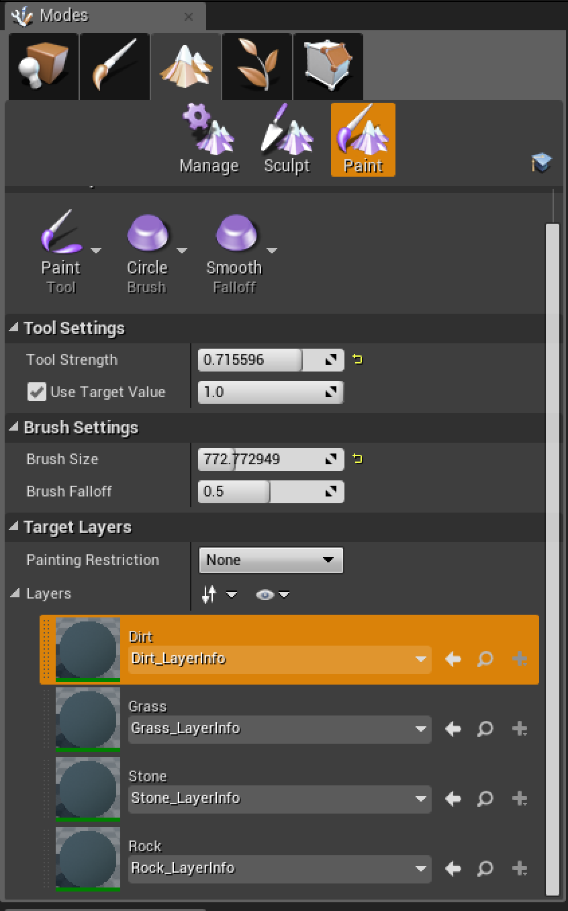
Paint Tab
You use the Paint tab of the Landscape panel to paint Material layers on a Landscape Actor.
This tab provides many of the same setups and tools as the Sculpt tab.
There are three menus: Tool, Brush, and Falloff. Each of these sections uses the same rules and applications as for the Sculpt tab, but instead applies the rules to the painting of Materials through layers.

Slide 20
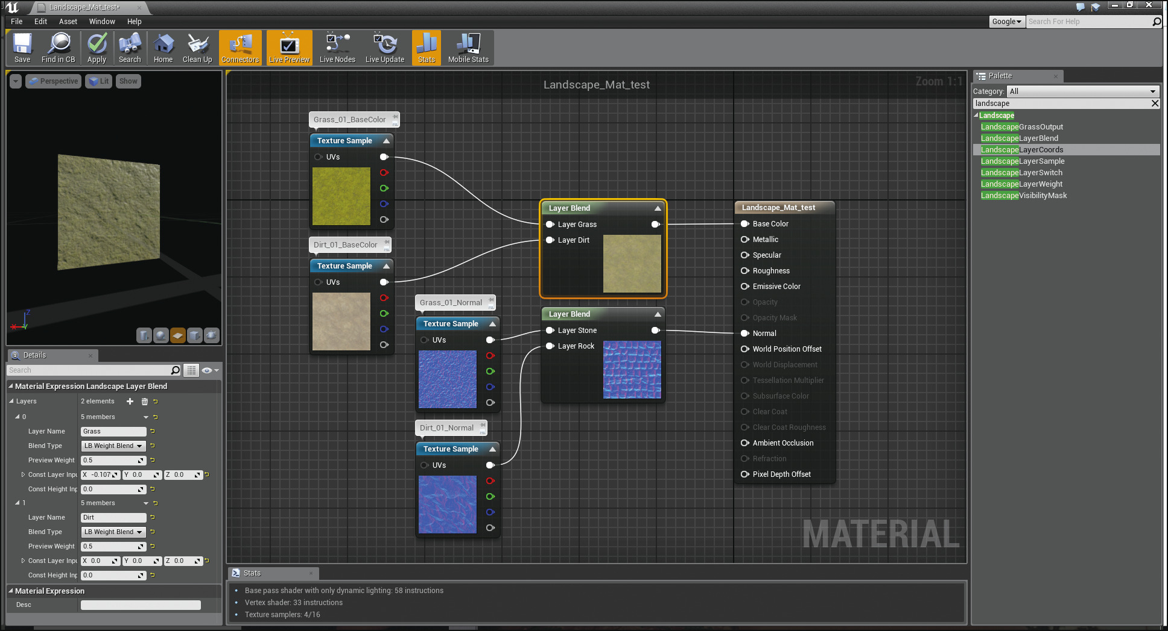
Landscape Materials
Landscape Materials are created the same way as other Materials, except that you need to use a LandscapeLayerBlend node. This node allows you to blend multiple Textures by assigning them to layers, and it works directly with the Landscape Paint tools.

Slide 21
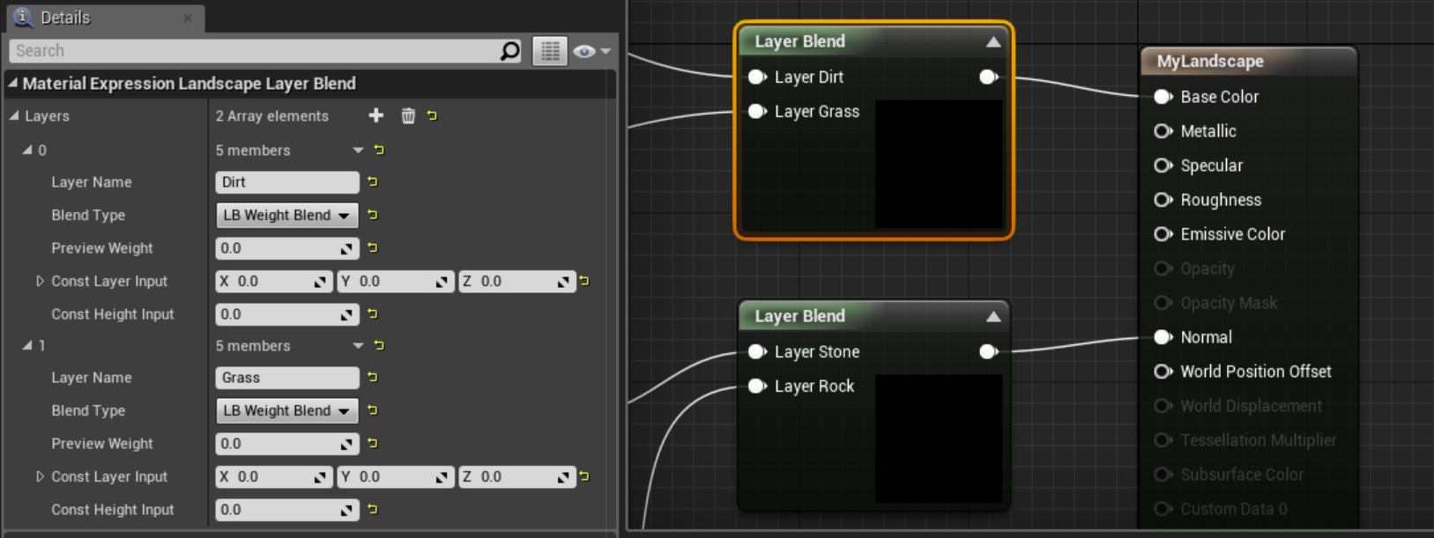
Landscape Materials
The LandscapeLayerBlend node can be added from the Palette panel on the right of the Material Editor. Once it has been added to your Material, you can select the node and in the Material Editor Details panel click the plus symbol to add new layers.

Slide 22
Landscape Materials
The blending types are available in the details of the LandscapeLayerBlend node for each layer. There are three types of blending methods:
LB_WeightBlend: This is the default type of blend for any type of Landscape layer. It blends on an additive value of 0 to 1. The more of the layer that is painted on the Landscape, the more predominately visible the layer becomes.
LB_HeightBlend: This type blends based on the associated height map assigned with the height layer input of the LandscapeLayerBlend node.
LB_AlphaBlend: This type is similar to the blend for normal Materials in a vertex, which use a mask to divide the transition of Textures between layers. Using a specific map, the layers are divided and transition based on the gray scale of the alpha map.

Slide 23
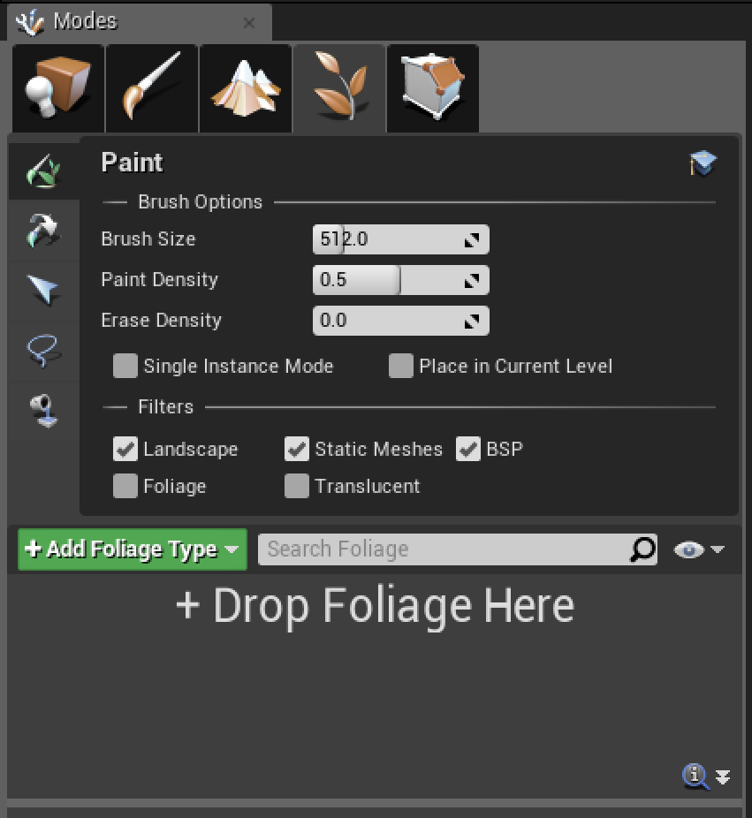
Foliage Panel
Imagine trying to hand-place the individual elements of an entire forest. Hand-placing individual trees, rocks, and grass would take forever.
The Foliage panel contains a collection of tools for placing a large number of assets into a scene quickly, using defined parameters and restrictions on where they can be placed.

Slide 24

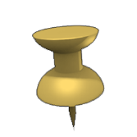
Working with Landscapes
Foliage Panel
Foliage is a collection of assets placed on top of and in direct relation to the Landscape mesh or other assets in a scene. Foliage Actors can be any type of Static Mesh asset that is available through the Content Browser. Simply dragging and dropping a mesh to the Foliage tab enables it to be used as a Foliage Brush asset.

Slide 25
Foliage panel
Tool | Description
Paint | The most commonly used tab for foliage, Paint controls painting options of the Static Meshes and what kinds of surfaces are affected.
Reapply | This tab applies current settings to all of the currently placed Foliage Static Meshes. It is useful if changes have been made to the settings of a Foliage Static Mesh after it has been placed within the scene.
Select | This tab allows you to select certain groups of selections in the entire world space of Foliage Static Meshes.
Lasso | This tab allows you to select certain groups of selections of Foliage Static Meshes.
Fill | This tab allows you to fill complete selections in the scene with the desired Foliage Static Mesh.
There are five tabs in the Foliage panel.

Slide 26
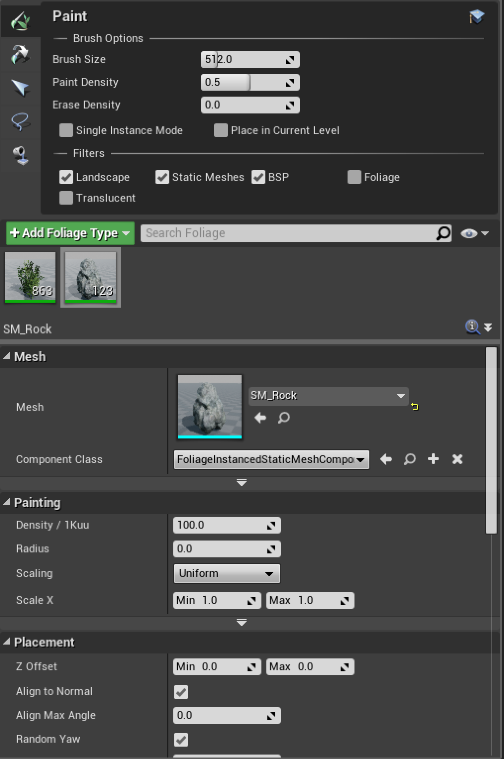
Foliage Panel
To place foliage within a scene, you must have at least one Static Mesh added to the Foliage tab.
To add a Static Mesh asset to the Foliage tab, simply drag it from the Content Browser.

Slide 27
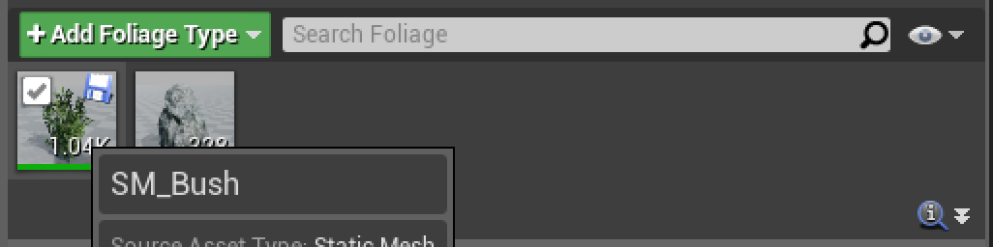
Foliage Panel
Each added Static Mesh has its own settings and rules for how it should be applied to the scene.
You can select and paint all the Static Meshes in groups or individually by toggling them on and off.
To toggle a Static Mesh, simply click the icon of the asset and select the check box in the top left corner.
To toggle it off, deselect the check box.
All toggled-on assets paint at once when you’re using the Foliage Brush within the scene.

Slide 28
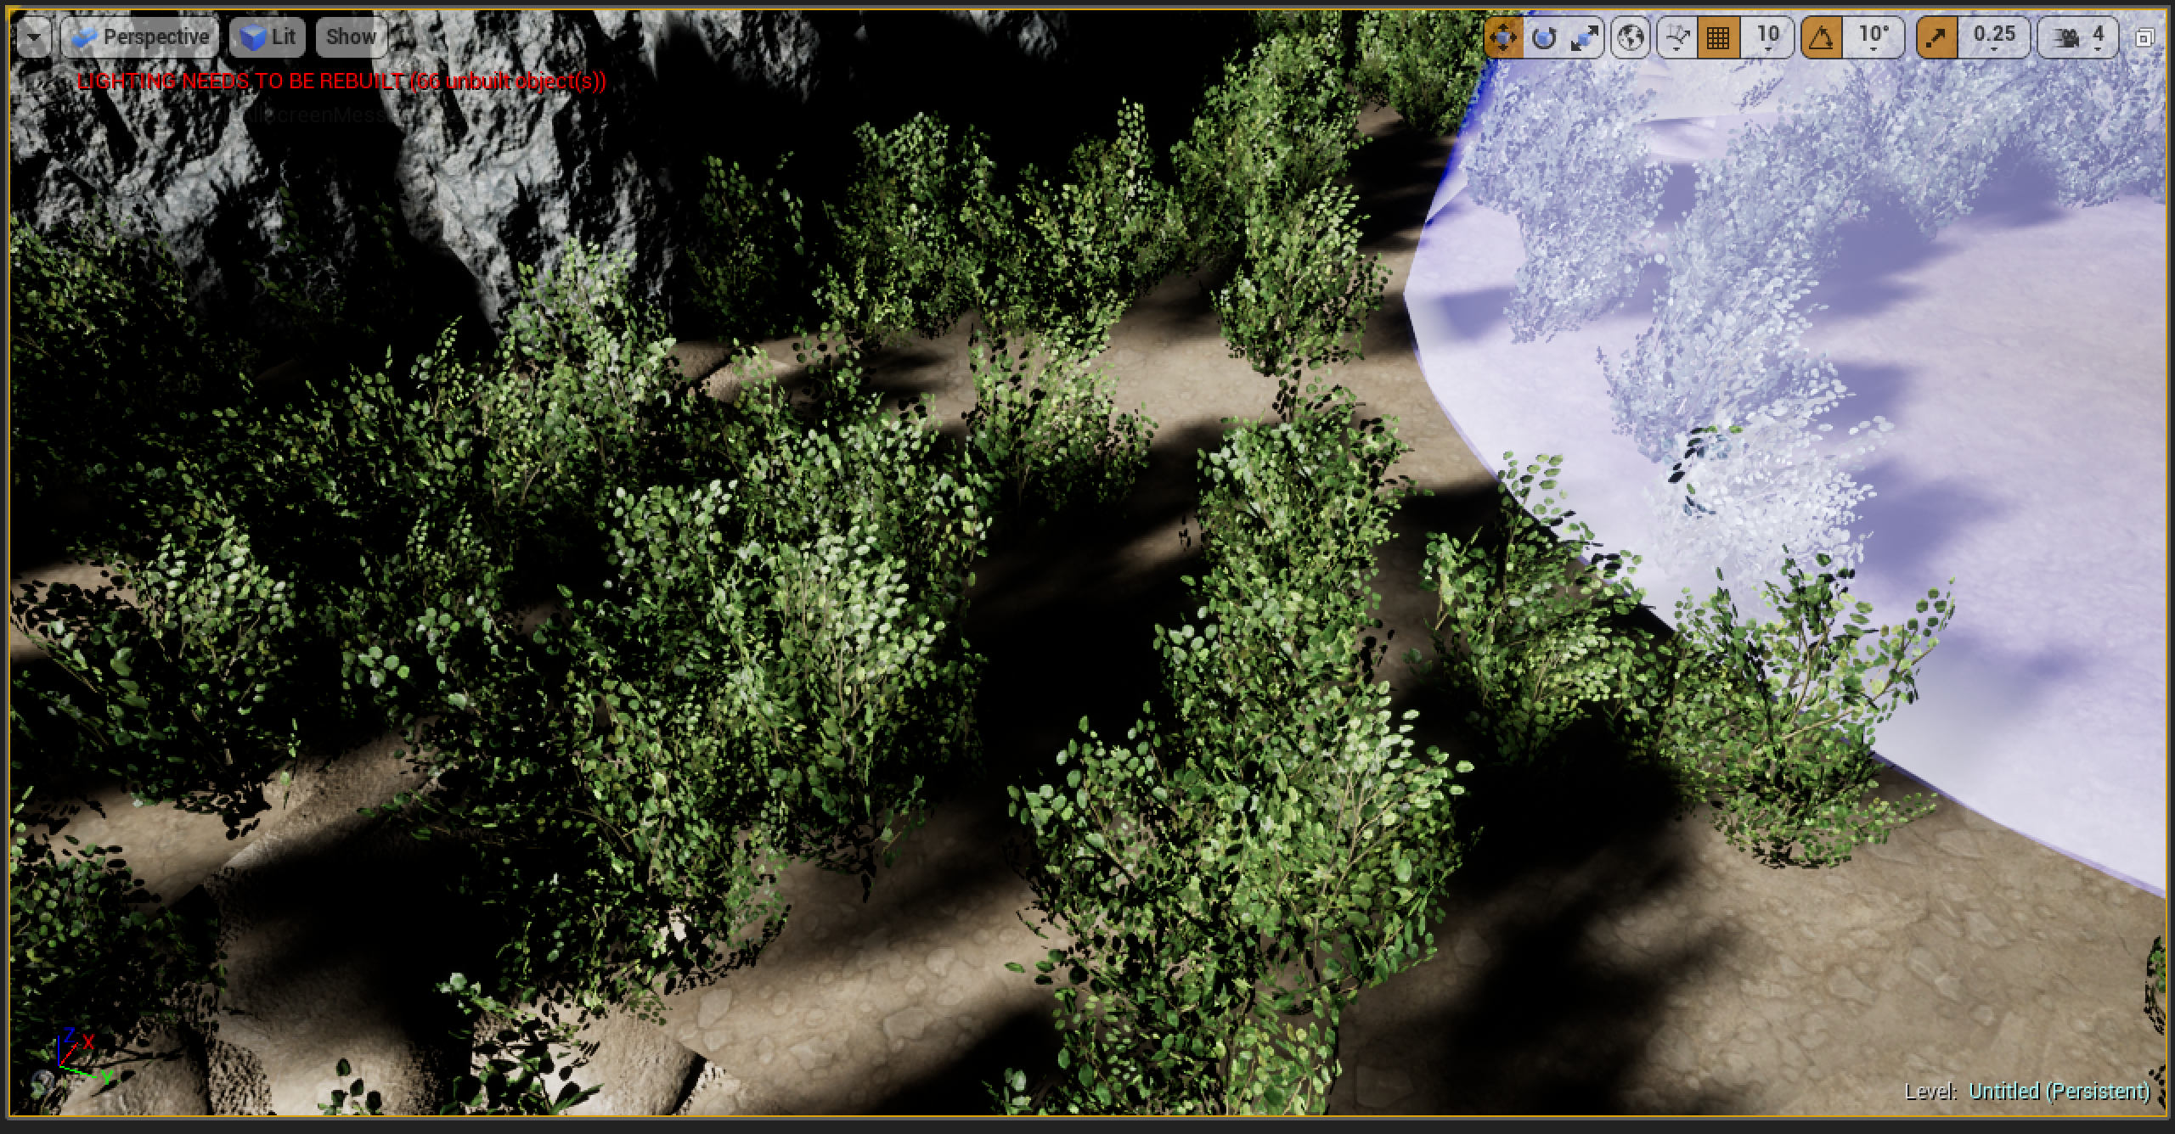
Foliage Panel
To paint with selected Foliage, left-click anywhere in the scene. When you do this, you begin to place assets based on the settings of the brush for each assigned Static Mesh.
To delete placed Foliage Actors, hold down the Shift key and left-click, and drag to paint back onto the area that was previously painted.

